Slide 1
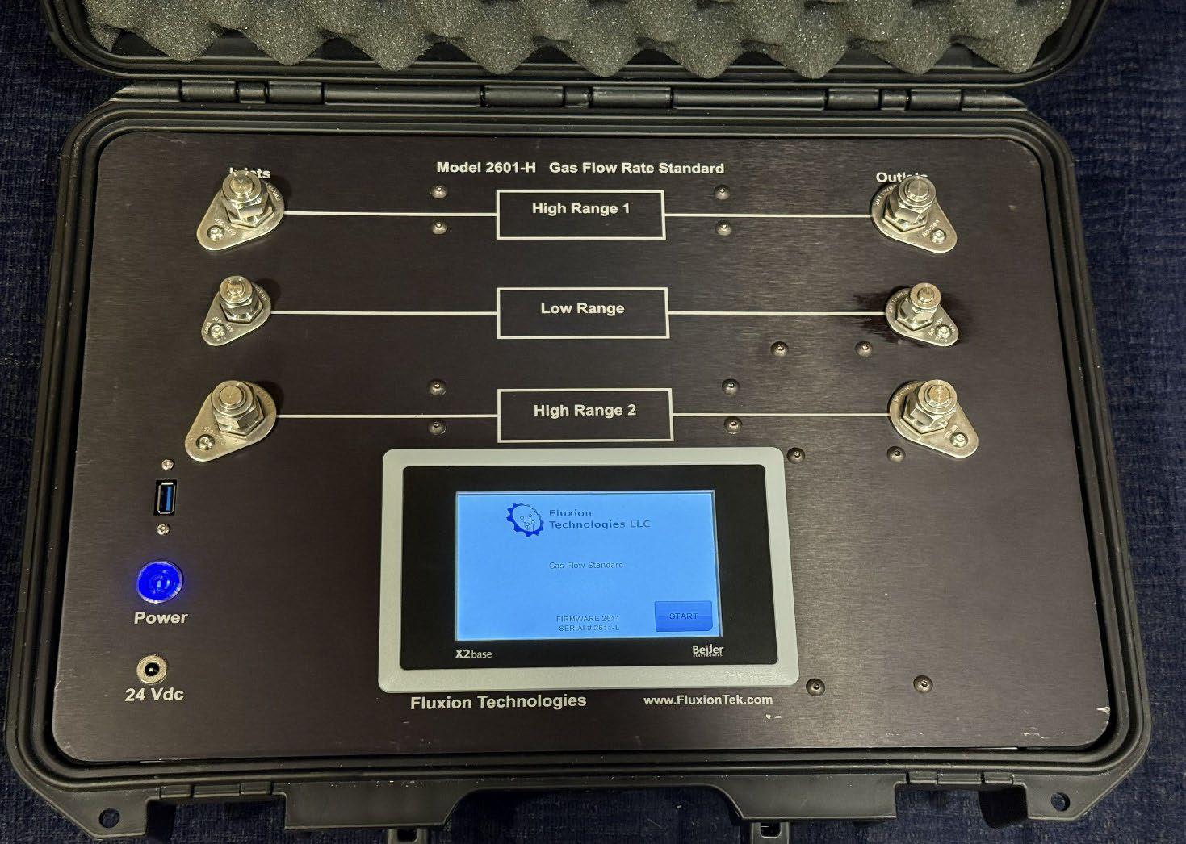
FLUXION TECHNOLOGIES
Model 2601-H
Portable Gas Flow Standard
Laboratory-grade flow calibration and measurement —
anywhere your work takes you.
3
10,000:1
±0.6%
Independent Ranges
Turndown per Range
of Reading Accuracy
Model 2601-H · Shown in rugged field case
www.FluxionTek.com

Slide 2
What Is the Model 2601-H?
A three-range, compact, lightweight instrument that serves as both a portable flow transfer standard and a precision flow meter — bringing calibration-lab performance directly to the point of use.
Flow Transfer Standard
Verify and calibrate other flow instruments in the field or lab — traceable, repeatable reference measurements at your fingertips.
Precision Flow Meter
Measure gas flow directly across three independent ranges, with live pressure and temperature readings on a 5" color touch screen.
Built for Portability
Battery-powered for up to 10 hours of continuous operation, packaged in a rugged case that travels from bench to plant floor.

Slide 3




100% Digital Instrumentation
At the heart of the 2601-H is a laminar flow element (LFE) meter with fully digital signal processing — a fundamentally more stable approach than conventional thermal mass meters.
No Warm-Up Time
Near-Instant Response
Ready to measure the moment it powers on — unlike thermal mass meters that need time to stabilize.
Typical response to flow changes in under 10 ms, with digital filtering to minimize scatter.
Long-Term Accuracy
Touch-Screen Calibration
The LFE holds its calibration longer, with minimal drift and touch-screen zeroing before every use.
Zero and span are set digitally on screen; constants are stored in the meters themselves — never lost with a display swap.

Slide 4






Key Features
Everything a working flow standard should have — and nothing that slows you down.
Three Independent Ranges
10,000:1 Turndown
5" Color Touch Screen
Full scales from 20 sccm to 250 slpm; special ranges to 0.5 sccm available.
Each range reads from 0.01% to 100% of full scale.
Intuitive navigation for testing, settings, and on-screen calibration.
10-Hour Battery
USB Data Logging
Flexible Configuration
Internal rechargeable 24 Vdc battery or wall power — charges while plugged in.
Time-stamped flow and pressure data recorded to Excel-ready files.
Gauge, absolute, or barometric pressure; multiple gases; high-pressure and corrosive-gas options.

Slide 5
Performance That Speaks for Itself
±0.6%
<10 ms
±0.5%
of reading flow accuracy
typical response time
pressure accuracy
(or ±0.1% FS, whichever is greater, after tare)
near-instantaneous reaction to flow changes
of reading after tare
Full Scale Ranges
Repeatability
Ranges 1 & 2: 20 sccm – 250 slpm · Range 3: 20 sccm – 20 slpm
±(0.1% of reading + 0.02% of full scale)
Pressure Range
Operating Temp.
11.5 – 160 psia standard; up to 320 psia optional
40 °F to 120 °F
Connections
Size & Weight
¼" and ⅜" compression fittings or ¼" FNPT
18.2" × 13.4" × 6.7" · approx. 17 lb (7.7 kg)
All units custom-built to order — contact Fluxion for a quotation.

Slide 6





Where the 2601-H Goes to Work
One instrument, from the calibration bench to the plant floor.
Flow Meter Calibration & Verification
Leak Rate Testing Programs
Use as a portable transfer standard to check and calibrate flow meters, controllers, and rotameters — in the lab or in the field.
Verify leak rate monitors and test instrumentation used in containment and component leakage testing programs.
Manufacturing & Process QA
Laboratory & R&D
Confirm gas delivery rates in production lines, gas panels, and test stands where flow accuracy drives product quality.
A wide-turndown benchtop reference for research, prototype testing, and experiments spanning sccm to slpm flows.
Field Service & Commissioning
Documented Test Records
Battery power and a rugged case make on-site instrument checks and system commissioning practical anywhere.
Log time-stamped data to USB for audit-ready records of every calibration and verification run.

Slide 7
Precision You Can Carry.
The Model 2601-H puts a full calibration laboratory's confidence into a single portable case. Every unit is custom-built to your specifications.
Request a Quotation
Fluxion Technologies, LLC
+1 (847) 971-8231 · Sales@FluxionTek.com
www.FluxionTek.com

