Slide 1

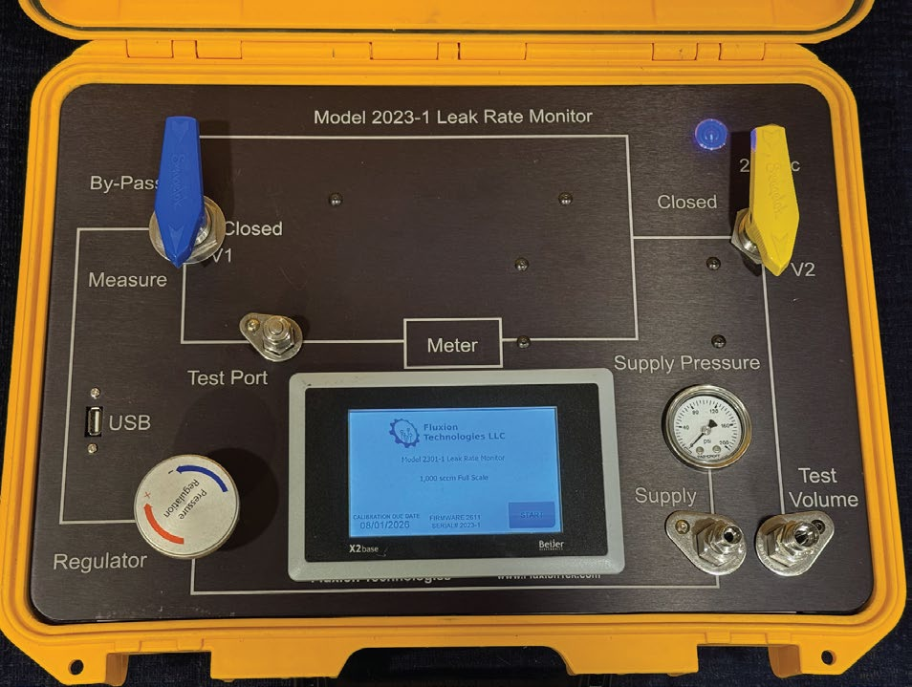
FLUXION TECHNOLOGIES
Precision Gas Flow Measurement Solutions
Model 2023-1
Leak Rate Monitor & Flow Standard
Fast, portable leak measurement for valves, fittings, and penetrations
www.FluxionTek.com · +1 (847) 971-8231

Slide 2
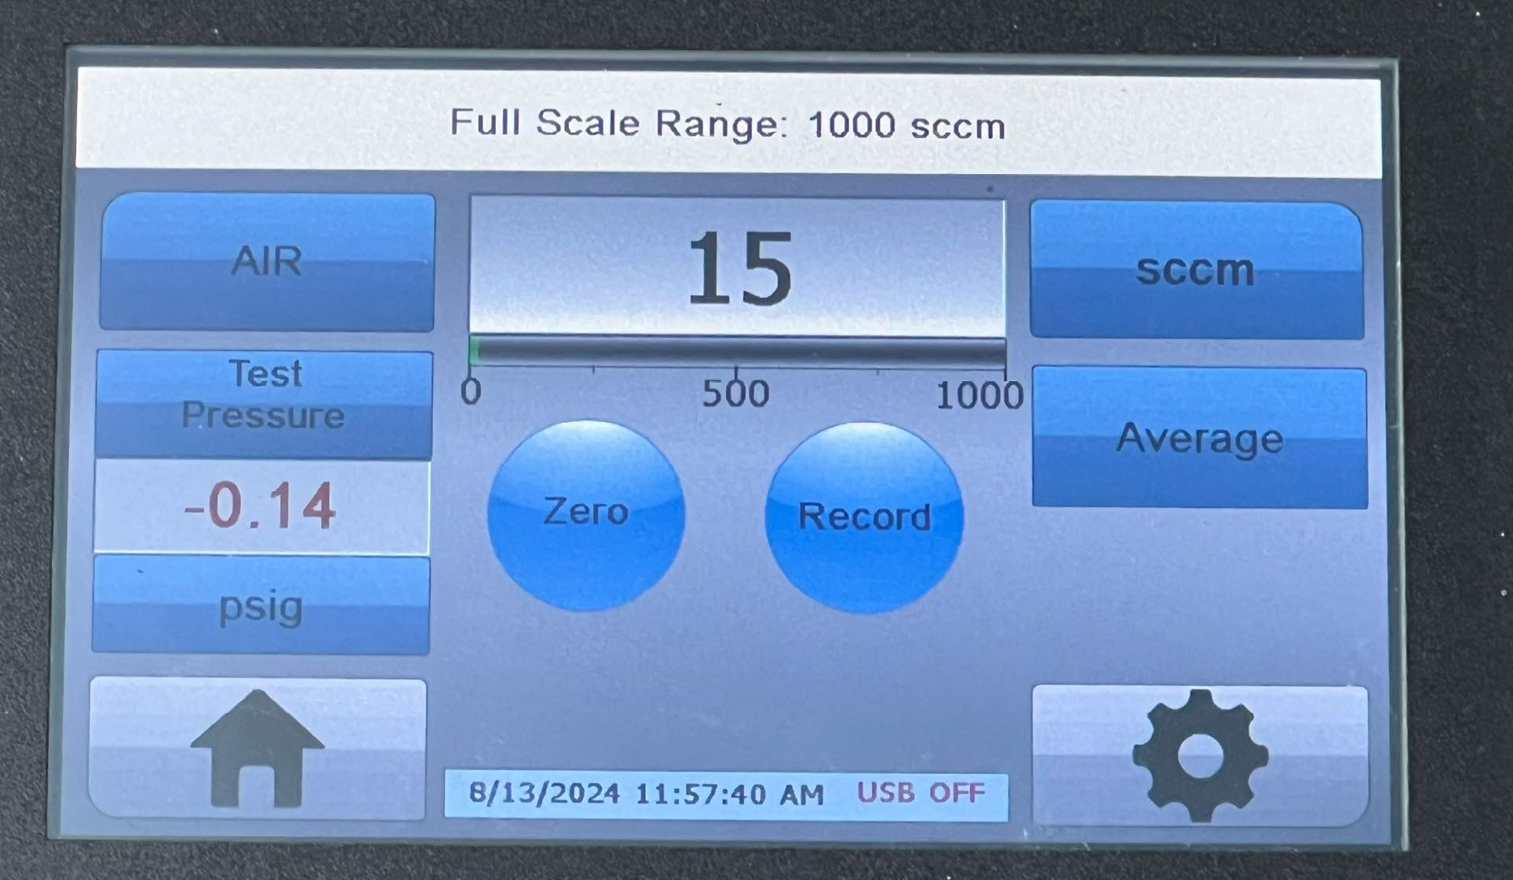
What is the 2023-1?
A rugged, highly portable leak rate monitor that measures how much a sealed component leaks — quickly, accurately, and right at the point of test. It doubles as a portable flow transfer standard for verifying other flow instruments.
Using the flow make-up method, the 2023-1 holds the test volume at pressure with its precision regulator and reads the make-up flow directly as the leak rate — no pressure-decay math, no waiting.
Live leak rate on the Test screen — one-touch Zero, Average, and Record
1,000 : 1
< 1 sec
10 hrs
turn-down ratio for wide leak ranges
warm-up — instant ready
battery for a full day in the field

Slide 3
What It Does — Leak Testing Made Simple
1
Connect & fill
Hook up the test volume; the built-in bypass quick-fills even large components
2
Set test pressure
The precision bleeding/relieving regulator holds pressure rock-steady
3
Read the leak
Make-up flow shown live in sccm — that IS the leak rate
The complete 2023-1 — regulator, valves, meter, and touch screen in one rugged case
4
Record to USB
Time-stamped, Excel-ready data at the press of a button

Slide 4






Key Capabilities
Wide Measuring Range
Instant-On Accuracy
Touchscreen Control
1,000:1 turn-down; full-scale builds from 20 sccm to 250 slpm
Laminar flow element — no warm-up, <10 ms response, ±1% of reading
5″ rugged color display: gas select, zero, averaging, calibration
USB Data Logging
Truly Portable
Built to Order
Time-stamped leak data straight to Excel-ready files
Battery or 24 Vdc wall power; carry-on case, ~17 lb
¼″/⅜″ connections, high-pressure to 320 psia, gas mixtures supported

Slide 5
Technical Specifications
Flow accuracy
±1% of reading or ±0.1% of full scale (whichever is greater)
Repeatability
±(0.1% of reading + 0.02% of full scale)
Rangeability
0.1% to 100% of full scale (1,000:1 turn-down)
Response time
< 10 ms typical · warm-up < 1 second
Test pressure
100 psig full scale (or specified) · ±0.5% FS after tare
Pressure regulator
170 psig max inlet · 0–90 psig outlet · isothermal compensation
Pressure range
11.5–170 psia standard · 320 psia high-pressure option
Power
24 Vdc wall adapter or internal battery
Size / weight
18.2″ × 13.4″ × 6.7″ · approx. 17 lb (7.7 kg)
Available ranges: 20 sccm – 250 slpm single range · every unit custom-built to order

Slide 6




Where the 2023-1 Works
Component Leak Testing
Containment Penetration Testing
Valves, fittings, penetrations, and sealed assemblies — measured in minutes at the point of work
Purpose-built for local leakage rate testing programs — carry lab-grade accuracy into the plant
Flow Transfer Standard
Large-Volume Testing
Verify and calibrate other flow meters in the shop or the field
The bypass quick-fill brings big components up to pressure fast — less waiting, more testing
Fluxion Technologies, LLC · +1 (847) 971-8231 · Sales@FluxionTek.com · www.FluxionTek.com

